Slide 1
British Airways
Machine Learning Model

Slide 2
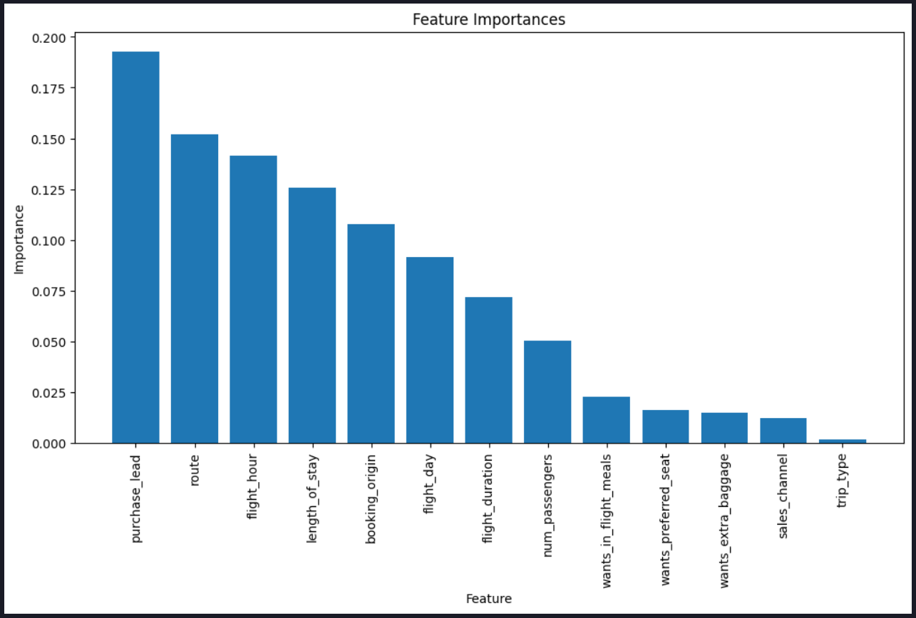
Feature Importance
Model Performance
Accuracy: 85.44%
Mean Cross-Validation Score: 48.51%
The model achieved an overall accuracy of 85.44%.
The performance for predicting bookings (class 1) is lower compared to non-bookings (class 0).

